Slide 1
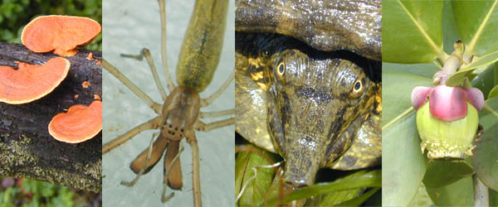
GENERAL BIOLOGY fdn 1203
Dr. Theja Abayarathna
Department of Biology
Faculty of Applied Sciences
Rajarata University of Sri Lanka

Slide 2
BIOMES

Slide 3
Biomes
Biome is the largest terrestrial community or the largest ecological unit.
It has specific kinds of plants and animals
It has distinct climatic conditions.
Biomes are distributed on earth as broad belts.

Slide 4
The major biomes
1.Tundra
Found across Asia, Europe and North America.
Rainfall below 25cm
Poor light and extremely low temperature.
Snowfall is scanty
Sparse vegetation.
Dwarf willow trees, lichens, mosses are found.

Slide 5
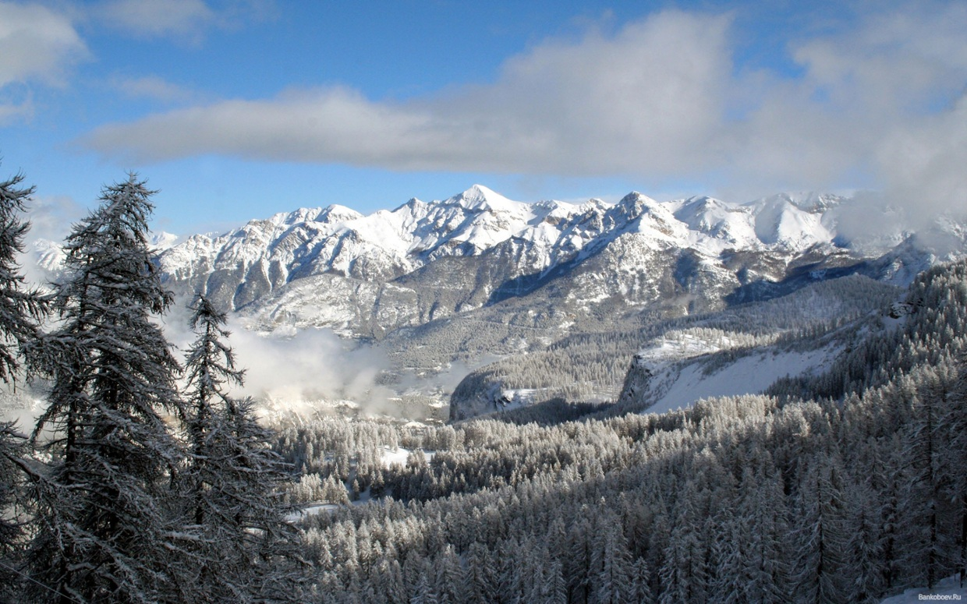
Tundra

Slide 6
2. Taiga
It is occurred at the east west band across North America, Europe and Asia.
Rainfall 10-35cm
Average temperature 6°C in winter and 20 °C in summer
Evergreen trees

Slide 7
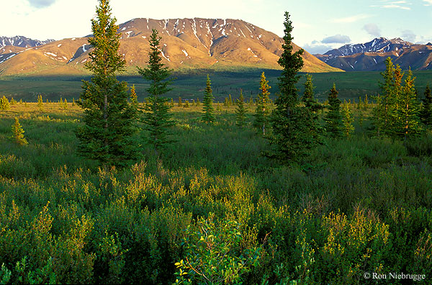
Taiga

Slide 8
3. Deciduous forest
Occurred in temperate region of North Central Europe, Easten Asia and Easten United states.
Rain fall 75-150cm
Broadleaved hardwood trees are found

Slide 9
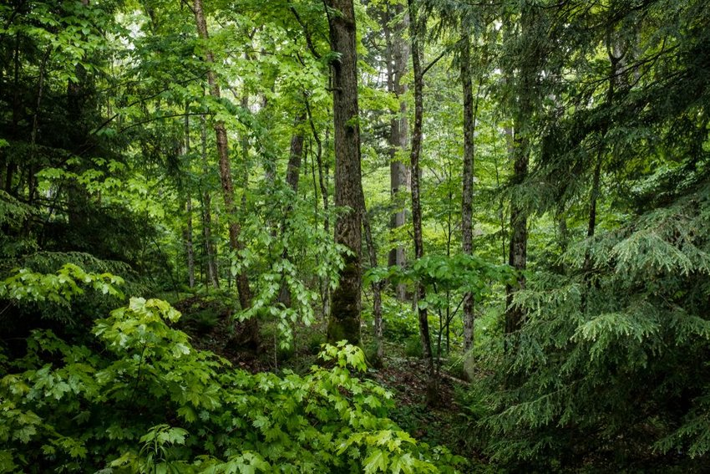
Deciduous forest

Slide 10
4. Tropical rain forest
Occurred in equatorial regions
Rainfall exceeds 140 cm
Warm and humid climate
Luxuriant and varied vegetation

Slide 11
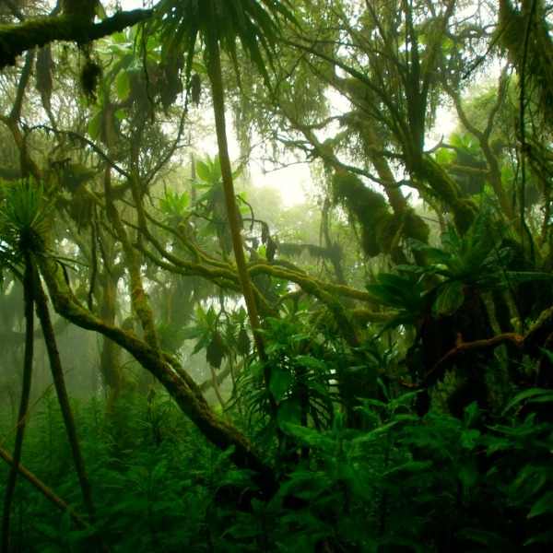
Tropical rain forest

Slide 12
5. Chaparral
Extends along Mediterranean sea, Pasific coast of south America, Chili, South Africa and south Australia.
Limited winter rain followed by drought.
Vegetation composed of broad-leaved evergreen shrubs, bushes, and small trees usually less than 2.5 m tall; together they often form dense thickets

Slide 13
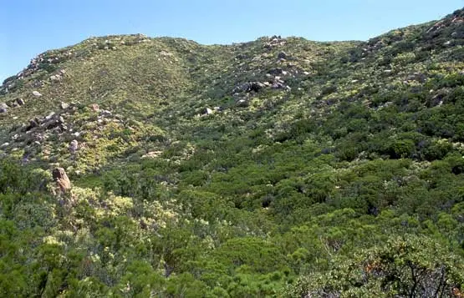
Chaparral

Slide 14
6. Tropical savannah
South America, Africa, Asia and Australia
Warm climate
Rain fall 100-150 cm

Slide 15
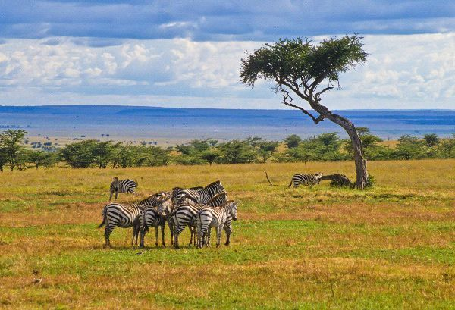
Tropical savannah

Slide 16
7. Grasslands
Prairies of Canada and USA, Pampas of Soth America, Stepps of Europe and Asia, Veldts of Africa
Rainfall is about 25-75cm
Short and tall grasses found

Slide 17
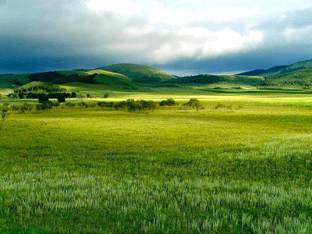
Grasslands

Slide 18
8. Desserts
South western USA, Mexico, coastal area of Chili and Peru, North Africa Sahara dessert
Extremely low rainfall. Less than 25cm, high evaporation.
Hardy grasses found.

Slide 19
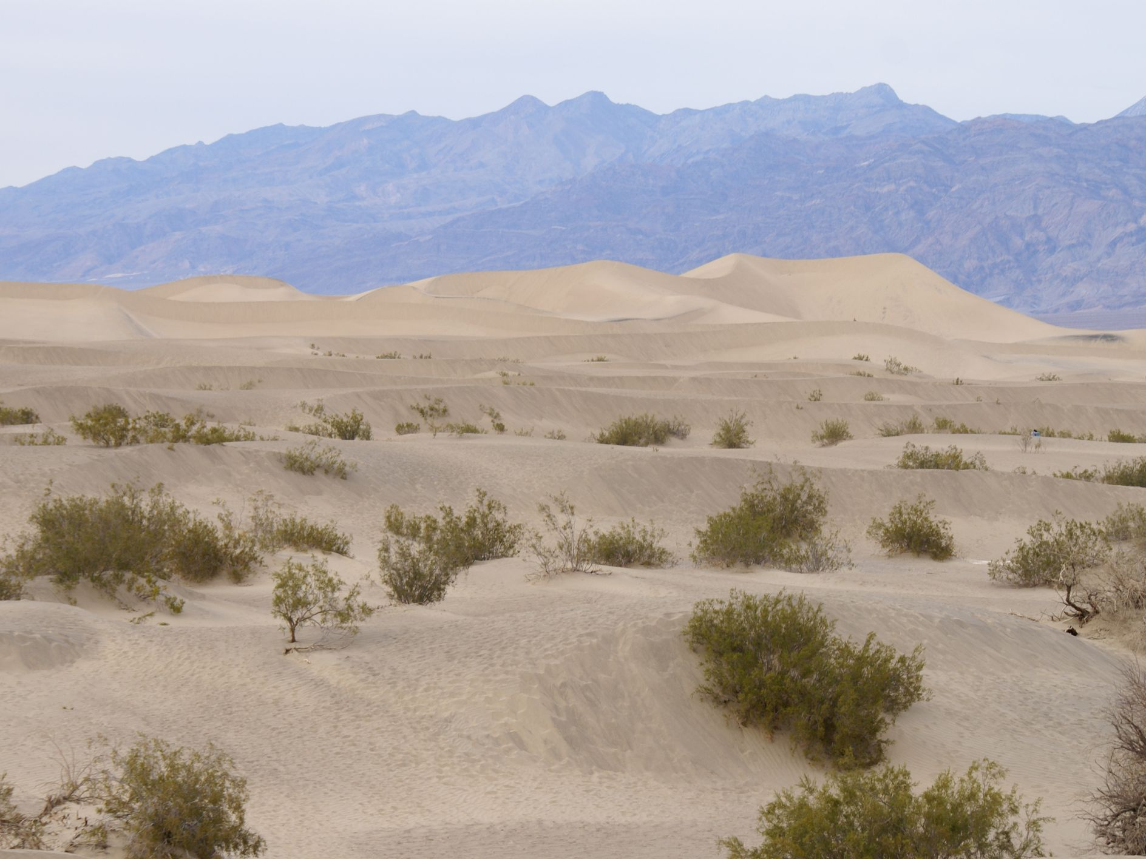
Desserts

Slide 20
Thank you!

